Slide 1
PROJECT TITLE
CSE7101- Capstone Project
Review-2
Batch Number: CCS-23
Under the Supervision of,
Dr./Mr./Ms./Prof.
Professor / Associate Professor / Assistant Professor
School of Computer Science and Engineering
Presidency University
Roll Number | Student Name
20231CCS3004 | SYED SAIFULLA H
20221CCS0012 | SIDDHARTH
20221CCS0036 | M CHINMAY
Name of the Program: Btech Cyber Security
Name of the HoD: Anandraj SP
Name of the Program Project Coordinator: Dr.Sharmasth Vali
Name of the School Project Coordinators: Dr. Sampath A K , Dr. Geetha A

Slide 2
Problem Statement Number:
Organization: Presidency University
Category (Hardware / Software / Both) : Software
Problem Description: This problem invites the development of a novel solution leveraging digital technology to address societal or administrative challenges within public services, sustainability, or governance

Slide 3
Content
Abstract
Literature Survey
Objectives
Exsisting method and drawbacks
Proposed Method & Drawbacks
Architecture Diagram
Methods
Timeline of the project (Grantt Chart)

Slide 4
Abstract
Fake social media profiles are widely used for spreading misinformation, scams, and impersonation. This project develops a web-based system that allows users to report and detect suspicious accounts through predefined rules and validation checks. The system integrates a simple frontend interface for users and a backend API that verifies profile details such as completeness of information, abnormal follower-to-following ratio, repetitive content, and presence of suspicious links. The backend stores and processes these reports, while an administrator reviews and takes appropriate action. This approach ensures a practical, resource-friendly, and real-time detection and reporting platform

Slide 5
Literature Survey
"Detecting Fake Profiles in Online Social Networks Based on Behavior Analysis" (IEEE, 2018): This paper explores the use of behavioral patterns, such as posting frequency, friend request patterns, and content similarity, to identify fake profiles. While the original paper uses machine learning, the underlying behavioral analysis principles can be adapted using rule-based systems.
"A Survey on Fake Account Detection Techniques in Online Social Networks" (Scopus, 2019): This survey provides a broad overview of various fake account detection techniques, including content-based analysis, network-based analysis, and user behavior analysis. It highlights the strengths and weaknesses of each approach.
"Combating Fake News and Disinformation: A Review of Methods and Techniques" (Web of Science, 2020): Although focused on fake news, this paper discusses techniques for identifying the sources of disinformation, which often involve fake social media profiles. It emphasizes the importance of verifying information and identifying suspicious accounts.
"Social Media Data Mining and Analysis" (IEEE, 2015): This paper provides a foundational understanding of social media data analysis techniques, including network analysis and sentiment analysis. These techniques can be adapted to identify patterns associated with fake profiles.
"The Spread of Misinformation Online" (Scopus, 2017): This paper examines the mechanisms by which misinformation spreads online, often facilitated by fake accounts. It highlights the need for effective detection and reporting mechanisms.
"Analyzing User Behavior for Fake Account Detection in Social Networks" (Web of Science, 2016): This paper focuses on analyzing user behavior patterns, such as posting times, content types, and interaction patterns, to identify fake accounts.
"Detecting Social Bots in Online Social Networks: A Survey" (IEEE, 2019): While focused on bots, this survey provides insights into the characteristics of automated accounts, which often overlap with fake profiles.
"Fake Profile Detection in Online Social Networks: A Hybrid Approach" (Scopus, 2020): This paper proposes a hybrid approach that combines multiple detection techniques to improve accuracy.
"The Role of Social Media in Political Campaigns" (Web of Science, 2018): This paper examines the use of social media in political campaigns, including the use of fake accounts to spread propaganda and influence public opinion.
"Data Mining for Social Network Data" (IEEE, 2014): This paper provides an overview of data mining techniques applicable to social network data, including clustering and classification.

Slide 6
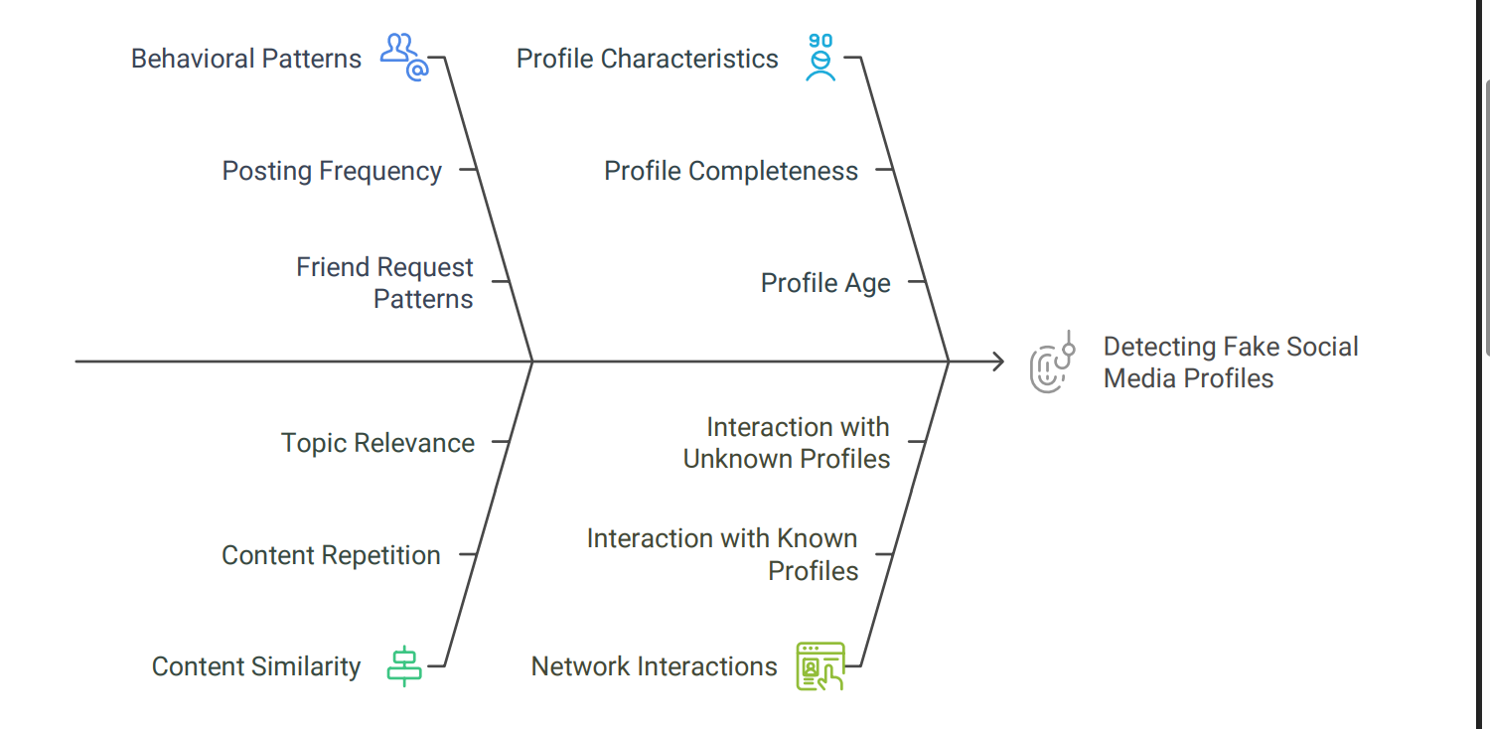
Literature Survey Contiuned

Slide 7
Objective
Develop a web-based platform: Create a user-friendly website that allows users to input social media profile URLs for analysis.
Implement rule-based detection: Implement a rule-based system to identify suspicious profiles based on predefined criteria (e.g., lack of profile picture, low follower count, suspicious posting patterns).
Integrate with social media APIs: Utilize social media APIs (e.g., Twitter API, Facebook Graph API) to gather profile data for analysis.
Enable user reporting: Provide a mechanism for users to report suspicious profiles to the platform administrators.
Generate reports: Generate reports summarizing the analysis results and providing evidence for the suspicion.

Slide 8
Object Continued
Develop Web
Platform
Integrate
Social Media
APIs
Generate
Reports
Create a user-
friendly website for
analysis
Gather profile data
using APIs
Summarize analysis
results and provide
evidence
Implement
Rule-Based
Detection
Enable User
Reporting
Provide a
mechanism for
users to report
profiles
Identify suspicious
profiles based on
criteria

Slide 9
Existing Methods and Drawbacks
Existing Methods and Drawbacks
Manual Reporting Systems: Rely on user complaints but often delayed and inconsistent.
Network-based Detection: Focuses on relationships but needs large datasets.
Content-Based Checks: Can identify spam but not always accurate.
Drawbacks:
Many methods are resource-intensive.
Delay in response to user complaints.
Lack of real-time, lightweight detection mechanisms.

Slide 10
Proposed Method & Feasibility Study
.
The proposed project adopts a rule-based + API-driven approach:
Frontend: Simple, user-friendly interface for users to submit suspicious profile details.
Backend API: Validates reports against predefined rules such as incomplete information, abnormal follower ratio, repeated suspicious posts, or spam links.
Database: Stores reported profiles, user complaints, and admin decisions.
Admin Module: Allows authorized users to review, verify, and take action.
Feasibility:
Technology: Web stack (HTML, CSS, JS for frontend; Node.js/Express or Django for backend; MySQL/MongoDB for database).
Cost: Minimal since all tools are open-source.
Resources: Works on standard PC/laptop or affordable cloud hosting.
This solution is practical, scalable, and implementable in an academic environment.
.

Slide 11
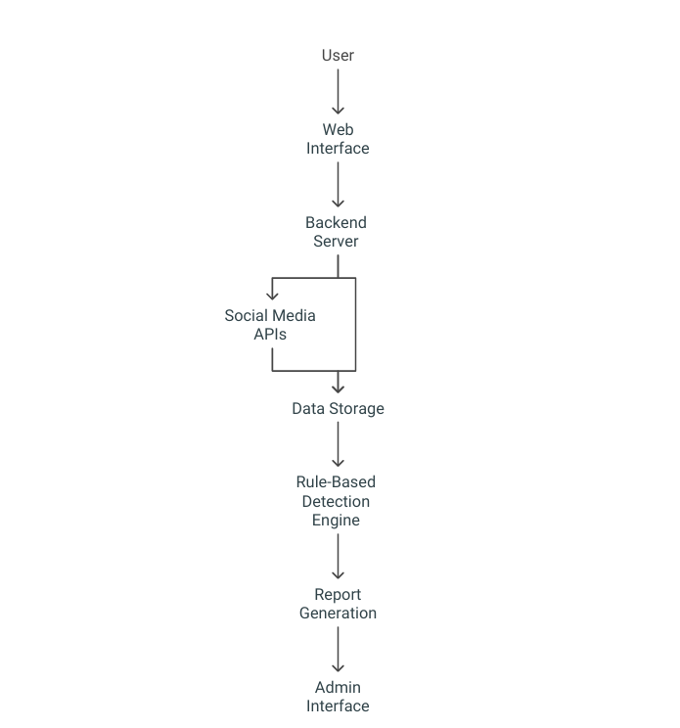
Architecture Diagram
Flow:
User (Frontend) → submits suspicious profile.
Backend API → applies rule-based validation.
Database → stores reports and logs.
Admin Module → reviews, verifies, and updates status.
Notification System → informs users of report outcomes.

Slide 12
Modules
User Module – Allows registration, login, and profile reporting.
Detection Module – Applies predefined rule-based checks for suspicious accounts.
Admin Module – Manages reports, verifies cases, and updates status.
Database Module – Stores user details, reported profiles, and actions.
Notification Module – Provides feedback to users about their repo
.

Slide 13
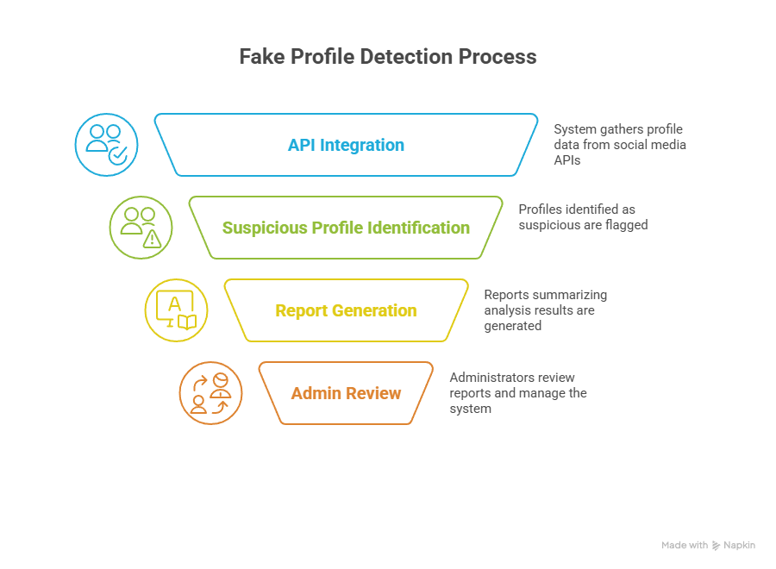
Modules Continued

Slide 14
Hardware and Software Details
Hardware:
  Web server (e.g., AWS EC2 instance, DigitalOcean droplet)
  Database server (e.g., AWS RDS, PostgreSQL)
Software:
  Operating System: Linux (e.g., Ubuntu, CentOS)
  Web Server: Apache or Nginx
  Programming Language: Python
  Web Framework: Flask or Django
  Database: PostgreSQL or MySQL
  Frontend: HTML, CSS, JavaScript
  Social Media APIs: Twitter API, Facebook Graph API

Slide 15
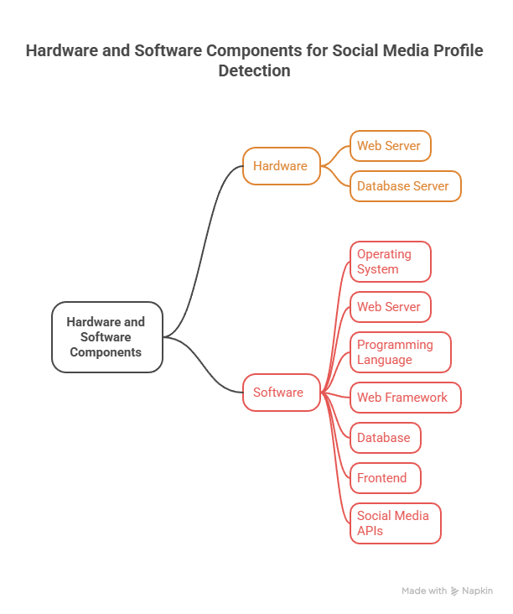
Hardware and Software Details Component Diagram

Slide 16
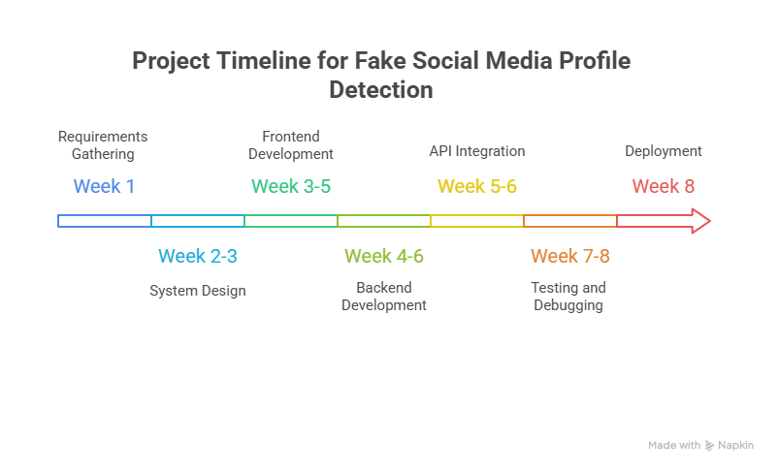
Timeline of the Project (Gantt Chart)

Slide 17
References (IEEE Paper format)
[1] S. Al-Qurishi, et al., “Detecting Fake Accounts in Online Social Networks,” IEEE Access, vol. 5, pp. 4761–4770, 2017.
[2] S. Cresci, et al., “Fake Followers Detection on Twitter,” Proc. of Social Media, 2015.
[3] J. Yang, et al., “Online Human-Bot Interactions,” First Monday, vol. 21, no. 11, 2016.
[4] A. Ahmed, et al., “Detection of Fake Facebook Accounts,” IJACSA, vol. 8, no. 5, 2017.
[5] M. Egele, et al., “Detecting Compromised Accounts on Social Networks,” NDSS Symposium, 2013.
[6] S. Kumar and N. Shah, “False Information on Web and Social Media,” ACM Computing Surveys, 2018.
[7] K. Thomas, et al., “Suspended Accounts in Twitter,” USENIX Security, 2011.
[8] A. Gupta, et al., “Survey of Fake Social Media Accounts,” IEEE ICACCI, 2016.
[9] F. Benevenuto, et al., “Detecting Spammers on Twitter,” Proc. CEAS, 2010.
[10] V. Varol, et al., “Analyzing Online Social Behavior,” Social Network Analysis Journal, 2017.

Slide 18


